Slide 1
Spreading the MDC Message
HSTW Summer Conference 2018
Kate Golden, Math Teacher, Cuyahoga Valley Career Center
KathrynMGolden@gmail.com
Lauren Visnick, Math Teacher, Cuyahoga Valley Career Center
Lvisnick@cvccworks.edu
Credit given to former co-presenter
Scott Graham, Math Teacher, High School Math Teacher, bhsmathguy@gmail.com
Website: http://thegoldenclassroom.weebly.com/

Slide 2
Questions we are looking to answer
What is MDC?
How can MDC help with math instruction?
How do we get people to buy into MDC?
How can I train others in MDC?
How can I help teachers after we train them in MDC?

Slide 3
What is MDC?

Slide 4
THE TRADITIONAL LESSON
Intro/
Hook
Traditional
Content Delivery
Reteach?
Assessment
Typical Unit of Mathematics Instruction

Slide 5
THE MDC LESSON
Intro/
Hook
Traditional Content Delivery
MDC
FAL
Fine
Tune
Assessment
2/3 to 3/4

Slide 6
What is Mathematics Design Collaborative?
The Mathematics Design Collaborative (MDC) are lessons or tasks that aims to bring to life the Common Core State Standards (CCSSM) in a way that will help teachers and their students turn their aspirations for achieving them into classroom realities.

Slide 7
The Mathematics Design Collaborative (MDC) provides schools with instructional tools needed to help teachers understand and implement the college- and career-readiness math standards effectively while allowing them the flexibility to select topics and adapt assignments to their specific instructional plans.

Slide 8
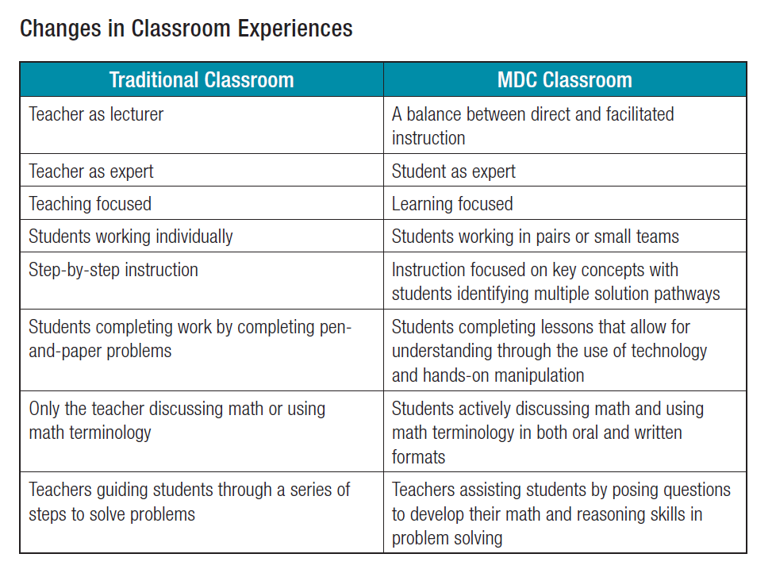

Slide 9
MDC Classroom Challenges
Lessons that support teachers in formative assessment. They both reveal and develop students’ understanding of key mathematical ideas and applications. These lessons enable teachers and students to monitor in more detail their progress towards the targets of the standards.

Slide 10
MDC Classroom Challenge Review
Concept Development Lesson
Focus on assessing and developing conceptual understanding
Problem Solving
Focus on the application of previously learned mathematics to non-routine problems.
Notes:
Concept Development
Help students and teachers realize the CCSSM requirement that “Proficient students expect mathematics to make sense.” These lessons are designed to reveal and develop students’ conceptions, and misconceptions, of significant mathematical ideas and how these connect to their other knowledge.
Problem Solving
Help students and teachers also realize the CCSSM requirement that “They take an active stance in solving mathematical problems.” These lessons are designed to assess and develop students’ capacity to apply their mathematics flexibly to non-routine unstructured problems, both from the real world and within pure mathematics.

Slide 11
Structure of a
Formative Assessment Lesson
Concept Development
Framing the lesson
Pre-lesson assessment
Introduction
Collaborative Activity
Whole-class Discussion
Feedback Questions
Post-lesson assessment
Problem Solving
Framing the lesson
Pre-lesson assessment
Feedback Questions
Introduction
Collaborative Activity
Examining Student Work
Whole-class Discussion
How Did You Work
Problem Solving
Framing the lesson
Pre-lesson assessment
Feedback Questions
Introduction
Collaborative Activity
Examining Student Work
Whole-class Discussion
Problem Solving
Framing the lesson
Pre-lesson assessment
Feedback Questions
Introduction
Collaborative Activity
Examining Student Work
Problem Solving
Framing the lesson
Pre-lesson assessment
Feedback Questions
Introduction
Collaborative Activity
Problem Solving
Framing the lesson
Pre-lesson assessment
Feedback Questions
Introduction
Problem Solving
Framing the lesson
Pre-lesson assessment
Feedback Questions
Problem Solving
Framing the lesson
Pre-lesson assessment
Problem Solving
Framing the lesson
Problem Solving
Framing the lesson
Pre-lesson assessment
Feedback Questions
Introduction
Collaborative Activity
Examining Student Work
Whole-class Discussion
How did you work?
VS.
Notes:
11:00-11:30
Differences in CD and PS Classroom Challenges
Comment on:
1. How are groups chosen within problem solving lessons?
2. Where are problem solving lessons placed within a unit?
Lead: Scott

Slide 12
How can MDC help with Math Instruction?

Slide 13
WHY MDC?
differentiated instruction in classrooms
formative assessment teaching practices
student improvement data
increased rigor (PARCC math assessment)
real world applications
CCSSM hardwired!

Slide 14
How MDC helps with Math Instruction?
Students’ understanding of the fundamental nature of mathematics expands and deepens when they engage in MAP Classroom Challenges.
The MAP Classroom Challenges enable classroom teachers to enact the Common Core State Standards in Mathematics (CCSSM) and Standards for Mathematical Practice (CCSSMP) in their classrooms.
The MAP Classroom Challenges engage and test students of all abilities, from those who have not previously participated in math classrooms to those who have consistently excelled.
Using MAP Classroom Challenges allows teachers to hear and see their students in new ways, thereby illuminating what they know and can do mathematically.
Source: MAP.MATSHELL.ORG
Brief Guide for Teachers and Administrators

Slide 15
How MDC helps with Math Instruction?
MAP Classroom Challenges demand that students talk and write about their mathematical understanding, and then analyze, synthesize, justify and often revise their thinking.
The MAP Classroom Challenges provide students learning experiences that “stress conceptual understanding of key ideas in mathematics,” the major goal of the CCSSM.
MAP Classroom Challenges help teachers shift from teacher-centered to student-directed classrooms, where responsibility for thinking and learning resides with students.
MAP Classroom Challenges enhance teachers’ instructional repertoire, enabling them to practice pedagogies such as active listening, questioning or facilitating small group discussions that promote deep mathematical learning.
Source: MAP.MATSHELL.ORG
Brief Guide for Teachers and Administrators

Slide 16
How do we get people to buy into MDC?

Slide 17
How do we get people to buy into MDC?
Have teachers actually complete a MDC lesson.
Show how it relates to formative assessment teachers are already doing in class.
Show how MDC can prepare students for Next Generation Assessments
Show how MDC can help with teacher evaluation
Show videos that express thoughts of teachers and students.
Provide support to teacher that are starting MDC.

Slide 18
How can I train others in MDC?

Slide 19
MDC Training
Day 1
Review of Formative Assessment
What is MDC?
Complete Concept Development as a large group
Go through MDC Resources for lesson
Complete Concept Development in Grade Level Groups. Thinking like a student.
Day 2
Review Formative Assessment
Review Format of Concept Development Lesson
Complete Problem Solving Lesson
Identifying student misconceptions and identify feedback that moves learning forward
Identify and plan a lesson to implement before
Resource: MDC Training Day 1
Resource: MDC Training Day 2

Slide 20
MDC Training Day 1

Slide 21
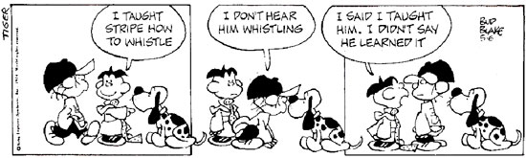

Slide 22
MDC Training
Day 1
Review of Formative Assessment
What is MDC?
Complete Concept Development as a large group
Go through MDC Resources for lesson
Complete Concept Development in Grade Level Groups. Thinking like a student.
Day 2
Review Formative Assessment
Review Format of Concept Development Lesson
Complete Problem Solving Lesson
Identifying student misconceptions and identify feedback that moves learning forward
Identify and plan a lesson to implement before
Resource: MDC Training Day 1
Resource: MDC Training Day 2

Slide 23
What are the biggest struggles we face as teachers in regards to students understanding of mathematics?

Slide 24
Paradigm Shift in Education
TED Talk: Sir Ken Robinson
Oct 14, 2010
Artwork by RSA Animate
https://www.youtube.com/watch?v=zDZFcDGpL4U&list=RDPtZ1pmY0VzI&index=4

Slide 25
Formative Assessment
An assessment functions formatively to the extent that evidence about student achievement is elicited, interpreted, and used by teachers, learners, or their peers to make decisions about the next steps in instruction that are likely to be better or better founded, than the decisions they would have made in the absence of that evidence.
--Dylan Williams
Embedded Formative Assessment

Slide 26
ONE BIG IDEA OF
FORMATIVE ASSESSMENT
Students and teachers continuously using evidence of learning to adapt what happens in the classroom

Slide 27
THE FORMATIVE ASSESSMENT PROCESS
 | Where the learner is going? | Where the learner is right now? | How does the learner get there?
Teacher | Clarifying and sharing learning intentions and criteria for success | Engineering effective classroom discussions, activities, and tasks that elicit evidence of learning | Providing feedback that moves learning forward
Peer | Understanding and sharing learning intentions and criteria for success | Activating learners as instruction resources for one another
Learner | Understanding learning intentions and criteria for success | Activating learners as the owners of their own learning
Source: NWEA/Dylan Williams
Resource: Formative Assessment Process

Slide 28
ONE BIG IDEA OF FORMATIVE ASSESSMENT
Students and teachers continuously using evidence of learning to adapt what happens in the classroom
FIVE KEY STRATEGIES OF FORMATIVE ASSESSMENT
Clarifying, sharing and understanding learning targets and success criteria
Engineering effective classroom discussions, questions and learning tasks that elicit evidence of learning
Providing feedback that moves learning forward
Activating students as the owners of their own learning
Activating students as instruction resources for one another
FORMATIVE ASSESSMENT TECHNIQUES
30-Second Share
Group Discuss Expectations
Rubrics
Looking at Previous Work
ABCD Cards
Exit Tickets
Diagnostic Questions
Find and Correct Errors
Two Stars and a Wish
Comment-Only Marking
Stop/Slow Signals
Question Strips
Traffic Lighting Self
Think/Write/Pair/Share
Carousel
Jigsaw
Source: NWEA/Dylan Williams
Resource: One Big Idea of Formative Assessment

Slide 29
MDC Training
Day 1
Review of Formative Assessment
What is MDC?
Complete Concept Development as a large group
Go through MDC Resources for lesson
Complete Concept Development in Grade Level Groups. Thinking like a student.
Day 2
Review Formative Assessment
Review Format of Concept Development Lesson
Complete Problem Solving Lesson
Identifying student misconceptions and identify feedback that moves learning forward
Identify and plan a lesson to implement before
Resource: MDC Training Day 1
Resource: MDC Training Day 2

Slide 30
What is Mathematics Design Collaborative?
The Mathematics Design Collaborative (MDC) are lessons or tasks that aims to bring to life the Common Core State Standards (CCSSM) in a way that will help teachers and their students turn their aspirations for achieving them into classroom realities.

Slide 31
MDC Classroom Challenges
Lessons that support teachers in formative assessment. They both reveal and develop students’ understanding of key mathematical ideas and applications. These lessons enable teachers and students to monitor in more detail their progress towards the targets of the standards.

Slide 32
MDC Classroom Challenge Review
Concept Development Lesson
Focus on assessing and developing conceptual understanding
Problem Solving
Focus on the application of previously learned mathematics to non-routine problems.
Notes:
Concept Development
Help students and teachers realize the CCSSM requirement that “Proficient students expect mathematics to make sense.” These lessons are designed to reveal and develop students’ conceptions, and misconceptions, of significant mathematical ideas and how these connect to their other knowledge.
Problem Solving
Help students and teachers also realize the CCSSM requirement that “They take an active stance in solving mathematical problems.” These lessons are designed to assess and develop students’ capacity to apply their mathematics flexibly to non-routine unstructured problems, both from the real world and within pure mathematics.

Slide 33
MDC Training
Day 1
Review of Formative Assessment
What is MDC?
Complete Concept Development as a large group
Go through MDC Resources for lesson
Complete Concept Development in Grade Level Groups. Thinking like a student.
Day 2
Review Formative Assessment
Review Format of Concept Development Lesson
Complete Problem Solving Lesson
Identifying student misconceptions and identify feedback that moves learning forward
Identify and plan a lesson to implement before
Resource: MDC Training Day 1
Resource: MDC Training Day 2

Slide 34
Lessons to go over as a large group
Comparing Lines and Linear Equations
(Good if you are doing just Middle School or both HS/MS)
Representing Quadratic Functions Graphically
(Good lesson to go over with just HS)

Slide 35
Throughout the Lesson
Show PowerPoint
Act like a teacher
Follow the script
Answer questions as that teachers have during the course of the lesson

Slide 36
As you go through the lesson
Think through the overall lesson and determine what the student’s and teacher’s roles are during the lesson.

Slide 37

Goals and Standards of the Lesson

Slide 38
Lesson Procedures
Pre-Assessment (20 min)
Whole class introduction (10 min)
    3) Collaborative activity #1:
    Matching Graphs (15 min)
    Sharing Work (10 min)
    Collaborative activity #2:
    Matching Graphs and Prisms (15 min)
    Whole class discussion (10 min)
    Follow up lesson:
    Reviewing the assessment task (15 min)

Slide 40
MDC Training
Day 1
Review of Formative Assessment
What is MDC?
Complete Concept Development as a large group
Go through MDC Resources for lesson
Complete Concept Development in Grade Level Groups. Thinking like a student.
Day 2
Review Formative Assessment
Review Format of Concept Development Lesson
Complete Problem Solving Lesson
Identifying student misconceptions and identify feedback that moves learning forward
Identify and plan a lesson to implement before
Resource: MDC Training Day 1
Resource: MDC Training Day 2

Slide 41
Discussion
Think through the overall lesson and determine what the student’s and teacher’s roles are during the lesson.

Slide 42
Go through MDC Resources for lesson
Take Time to first answer questions that people may have
  What do the lessons include?
  When do I do these lesson?

Slide 43
What do the lessons include?
Every resource you could possibly need for you and your students to be successful
Recommended Time allotments to complete each part of the lesson.
A Successful Lesson to use in class.
This lesson has been well researched and has been implemented all across the US and UK

Slide 44
When do I do these lessons?
At the Beginning of the year
  This can be used as a great way to see what material students remember from past years
  2/3 of the way through a Unit or lesson
  At the end of the year to measure students retention of topics taught

Slide 45
IMPORTANT
1) This is a Formative Assessment Lesson.
2) Students may struggle with this lesson and that is okay. You will have time to re-teach after the lesson.
This lesson is supposed to help us identify what we need to do after the lesson. Timing of the lesson is EXTREMELY IMPORTANT.
We are guides during the process. Remember it is ok for “productive struggle”

Slide 46
Go through MDC Resources for lesson
Take Time to first answer questions that people may have
  What do the lessons include?
  When do I do these lesson?
  Go through each component of lesson and why it is there and why it is important

Slide 47
Breaking down the lesson
Each Lesson has all the resources you could ever need to make you as a teacher successful.
You have the following resources provided to you:
Teacher Resources (T)
Student Resources (S)
Presentation Resources (P) with PowerPoint provided on map.mathshell.org

Slide 48
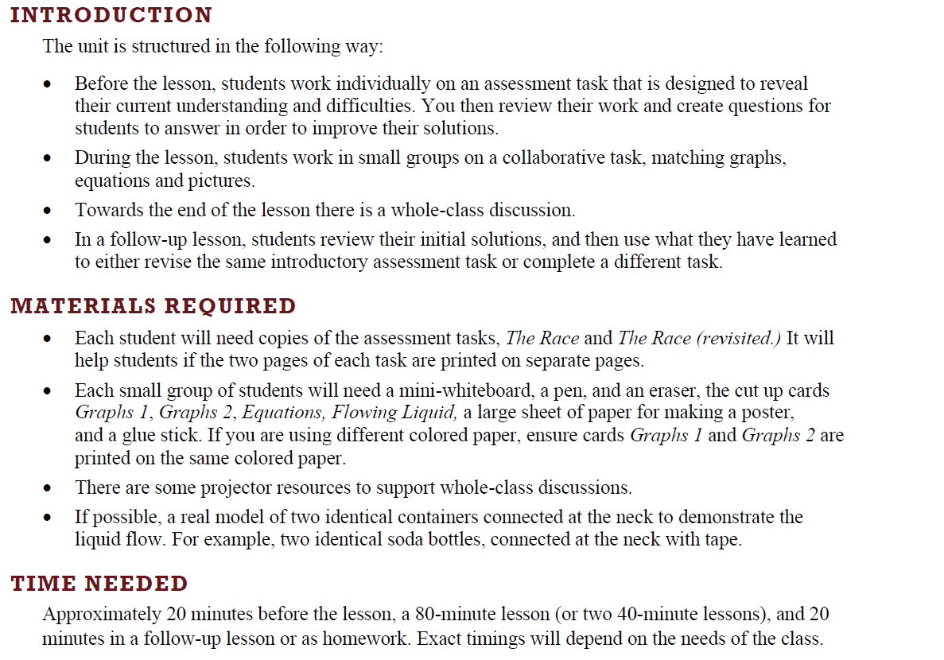
Introduction, Materials Needed Time (T1)

Slide 49
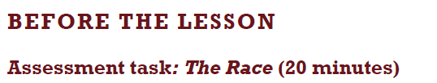
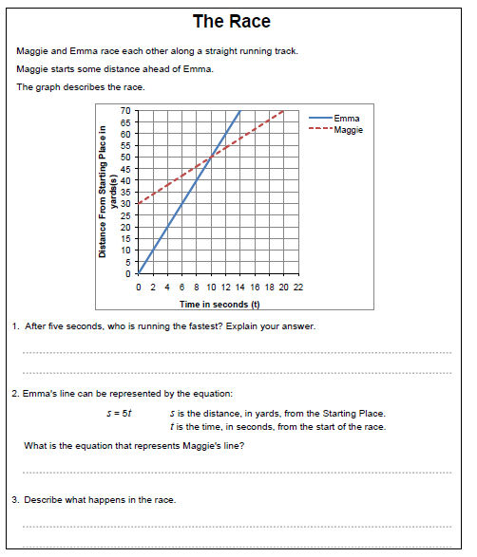
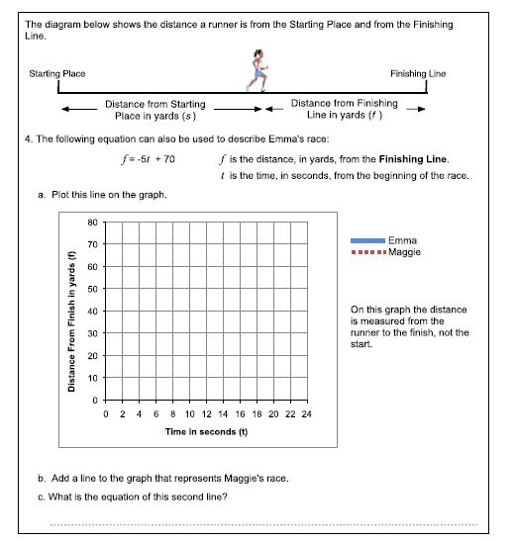
S1 and S2

Slide 50
Assessing Students’ responses
Do not score the responses on the pre-assessment. Research shows that students will focus on the score and other students scores rather than the math.
To move learning forward you will summarize their difficulties as a list of questions.

Slide 51
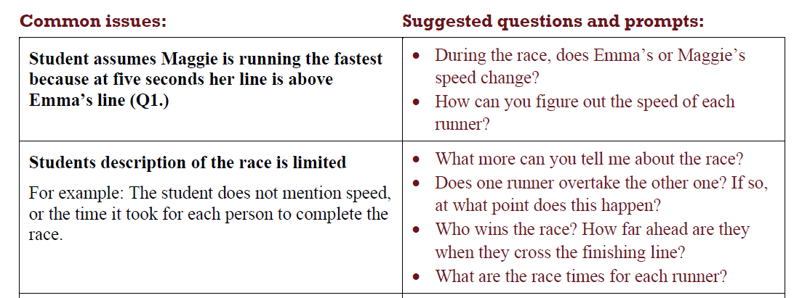
Assessing Students’ responses
T3

Slide 52
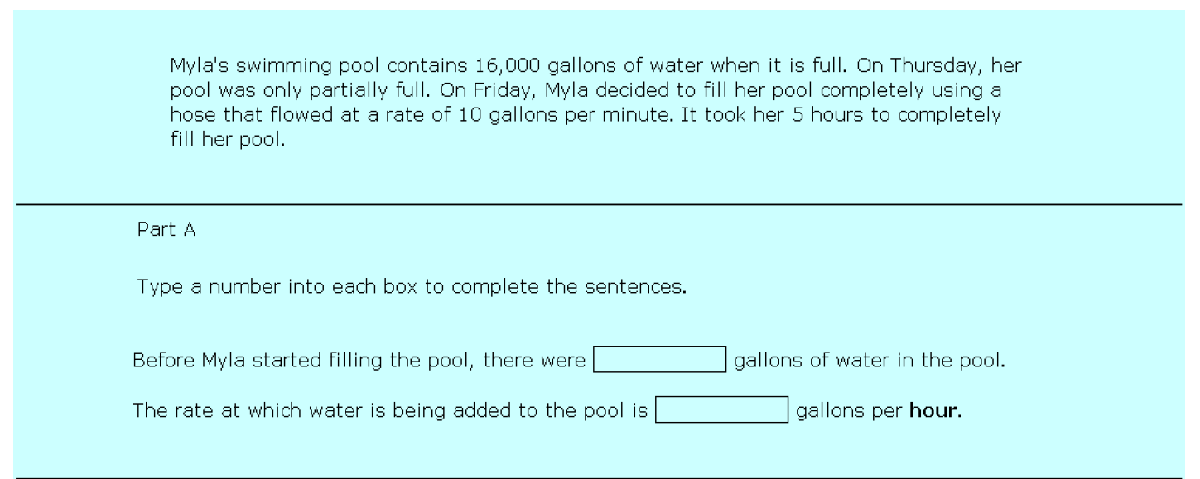
What about PARCC? How does it align with MDC?

Slide 53
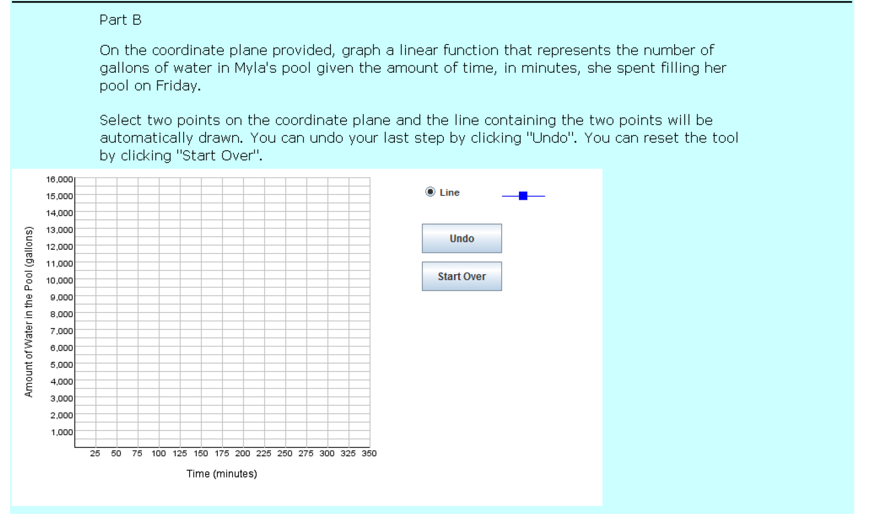

Slide 54
Resource: MAP Teacher Guide

Slide 55
MDC Training
Day 1
Review of Formative Assessment
What is MDC?
Complete Concept Development as a large group
Go through MDC Resources for lesson
Complete Concept Development in Grade Level Groups. Thinking like a student.
Day 2
Review Formative Assessment
Review Format of Concept Development Lesson
Complete Problem Solving Lesson
Identifying student misconceptions and identify feedback that moves learning forward
Identify and plan a lesson to implement before
Resource: MDC Training Day 1
Resource: MDC Training Day 2

Slide 56
Math Design Collaborative Implementation
Source: Making Mathematics Matter
Bill/Melinda Gates Foundation
https://www.youtube.com/watch?v=ga1WZ14o1TI

Slide 57
Looking at Grade Specific Lesson
6th Grade:
Adding and Subtracting Directed Numbers
7th Grade:
Using Positive and Negative Numbers in Context
8th Grade:
Building and Solving Linear Equations
Algebra I:
Solving Linear Equations in Two Variables
Geometry:
Sorting Equations of Circles 2
Algebra II:
Representing Polynomials Graphically

Slide 58
Familiarize Yourself with the Lesson
Do the pre-assessment.
Identify the Obstacles, Misconceptions and Gaps (OMG’s) of the pre-assessment.
Read the lesson plan through carefully, working the tasks and visualizing the sequence of activities for your students. Again, anticipate the different approaches students may take and the difficulties they will encounter. Also Identify the OMG’s of the lesson.
Resource: Lesson Worksheet

Slide 59
After Familiarizing Yourself with Lesson
3) What are the big mathematical ideas of the lesson?
4) What might be conceptually difficult? What ideas will need emphasis through questioning?
5) What type of questions can I ask my students to help them with the OMG’s of the pre-assessment and the lesson? You can look at the suggested questions in the lesson plan.
What questions might students ask? How will I respond and/or deal with these?
Resource: Lesson Worksheet

Slide 60
After Familiarizing Yourself with Lesson
7) What are the different strategies students may use?
8) What kinds of question might I ask students that are stuck, or are using an incorrect strategy etc.?
9) How can student-to-student discussion of the mathematics be encouraged?
Resource: Lesson Worksheet

Slide 61
Completing Pre-Assessment for
Problem Solving Lesson
Modeling Population Growth: Having Kittens
Generalizing Patterns: Table Tiles

Slide 62
Pre-lesson assessment task
Student instructions
Work on this task completely on your own (without help from me or from your fellow students).
I want to see how far you can go when presented with this problem. Expect to have to think about it. Read the task, look for a starting point, and then go back and re-read the task. Try to answer question/s as carefully as you can.
This will not be graded. It is designed to show me what issues might be impeding your learning and keeping you from higher test scores.
Tomorrow we are going to do a lesson which will help you complete this task.
Time: 15 minutes

Slide 63
MDC Training Day 2

Slide 64
MDC Training
Day 1
Review of Formative Assessment
What is MDC?
Complete Concept Development as a large group
Go through MDC Resources for lesson
Complete Concept Development in Grade Level Groups. Thinking like a student.
Day 2
Review Formative Assessment
Review Format of Concept Development Lesson
Complete Problem Solving Lesson
Identifying student misconceptions and identify feedback that moves learning forward
Identify and plan a lesson to implement before
Resource: MDC Training Day 1
Resource: MDC Training Day 2

Slide 65
The Big Idea of
Formative Assessment
Why is this the big idea of formative assessment?
Who: Students and teachers
What: Using evidence of learning to adapt teaching and learning
Why: To meet immediate learning needs
When: Minute-to-minute and day-by-day
Marnie Thompson and Dylan William (2008)
Ann Shannon and Associates (2013)

Slide 66
Where are you doing well, where could you improve?
5 Key Strategies for
formative assessment
Clarifying and sharing learning intentions and criteria for success;
Engineering effective classroom discussions, questions, and learning tasks;
Providing feedback that moves learners forward;
Activating students as instructional resources for one another; and
Activating students as owners of their own learning.
(Thompson and William, 2008)
Resource: Classroom Assessment: Minute by Minute, Day by Day,
Siobhan Leahy, Christine Lyon, Marnie Thompson and Dylan William
Embedded Formative Assessment, Dylan Williams

Slide 67
Group Activity: Formative Assessment
How do you implement Formative Assessment in your classroom?
Split teachers into five groups
Have each group look at each of the five formative assessment strategies and identify how they implement each of the strategies
Rotate ever two minutes
Have teachers at the last chart paper identify the best idea of that formative assessment strategy

Slide 68
MDC Training
Day 1
Review of Formative Assessment
What is MDC?
Complete Concept Development as a large group
Go through MDC Resources for lesson
Complete Concept Development in Grade Level Groups. Thinking like a student.
Day 2
Review Formative Assessment
Review Format of Concept Development Lesson
Complete Problem Solving Lesson
Identifying student misconceptions and identify feedback that moves learning forward
Identify and plan a lesson to implement before
Resource: MDC Training Day 1
Resource: MDC Training Day 2

Slide 69

OTES/Teacher Evaluation
And how it connects to MDC Classroom Challenges.

Slide 70
OTES/Teacher Evaluation
Materials Needed:
Chart Paper
Markers
Strategies to look at:
Lesson Delivery
Differentiation
Assessment of Learning
Assessment Data
Activity:
Split into four groups
Look at Teacher Evaluation Rubric and identify how and give evidence on how a MDC lesson can help you get Proficient/Accomplished
Present findings to all the teachers
Resource: OTES Rubric

Slide 71
Structure of a
Formative Assessment Lesson
Concept Development
Framing the lesson
Pre-lesson assessment
Introduction
Collaborative Activity
Whole-class Discussion
Feedback Questions
Post-lesson assessment

Slide 72
MDC Training
Day 1
Review of Formative Assessment
What is MDC?
Complete Concept Development as a large group
Go through MDC Resources for lesson
Complete Concept Development in Grade Level Groups. Thinking like a student.
Day 2
Review Formative Assessment
Review Format of Concept Development Lesson
Complete Problem Solving Lesson
Identifying student misconceptions and identify feedback that moves learning forward
Identify and plan a lesson to implement before
Resource: MDC Training Day 1
Resource: MDC Training Day 2

Slide 73
Enacting a Problem Solving Lesson
Purpose:
To familiarize you with the structure of a Problem Solving Lesson.
To address the differences in the two types of formative assessment lessons.
Notes:
9:10 – 9:30
Intro to Problem Solving Lesson
Pre-assessment for problem-solving
(break is embedded)
Lead: Sandra

Slide 74
Return your students’ work on the Table Tiles problem.
Ask students to re-read both the Table Tiles
problem and their solutions.
If you have not added questions to students’ work, write a short list of your most common questions on the board.
Students can then select a few questions appropriate to their own work and begin answering them.
Notes:
Start at 9:30 – 9:40
Generalizing patterns: Table Tiles
1. Improve individual solutions to the assessment task (10 minutes max)
Lead: Sandra

Slide 75
Organize the students into small groups of two or three. In trials, teachers found keeping groups small
helped more students play an active role.
Give each group a new sheet of grid paper.
Students should now work together to produce a joint solution.
You have two tasks during small-group work: to note different student approaches to the task, and to
support student problem solving.
Notes:
9:40-9:55
Collaborative small-group work (15 minutes)
Lead: Sandra

Slide 76
Table Tiles

Slide 77
Questions for Table Tiles
If you were to buy ¼ pieces, ½ pieces and whole piece how many would you need to buy for the 40cm by 40cm table?
Read the rubric. Where does Maria use quarter tiles? Half Tiles?
What do you notice about the difference between the numbers of whole tiles in one table top to the next?
4) What is the width and length of the table you just created in your diagram?
5) Figure out the number of ¼ pieces, ½ pieces and whole pieces of a 30x30 tabletop by drawing it. After figuring that, look at the 20x20 and 40x40 tile numbers. Without drawing make a hypothesis on the number of tiles (1/4 pieces, ½ pieces and whole pieces) needed for a 50x50 table. After making your hypothesis check to see if you were right.
6) How can you write your answer using mathematical language?
7) How could you explain how you reached your conclusions so that another class understands?

Slide 78
Student Responses to Discuss
Sample Responses to Discuss
Describe the problem solving approach the student used.
You might, for example:
    Describe the way the student has colored the pattern of tiles.
    Describe what the student did to calculate a sequence of numbers.
2. Explain what the student needs to do to complete his or her solution.

Slide 80
Videos of People Enacting Lesson
Collaborative Activity
http://vimeo.com/73705804
Classroom Discussion
http://vimeo.com/73706010

Slide 81
MDC Training
Day 1
Review of Formative Assessment
What is MDC?
Complete Concept Development as a large group
Go through MDC Resources for lesson
Complete Concept Development in Grade Level Groups. Thinking like a student.
Day 2
Review Formative Assessment
Review Format of Concept Development Lesson
Complete Problem Solving Lesson
Identifying student misconceptions and identify feedback that moves learning forward
Identify and plan a lesson to implement before
Resource: MDC Training Day 1
Resource: MDC Training Day 2

Slide 82
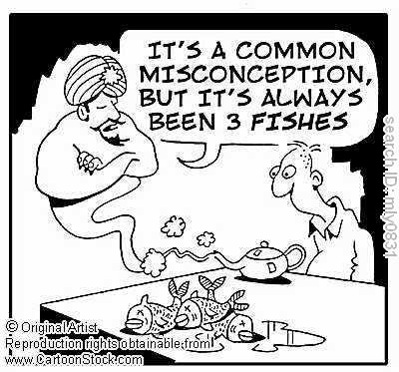
Standard Form: | Factored Form: 2 is greater than 4 | Completed Square Form:
y = x² – 10x + 24 | y = (x – 4)(x – 6) | y = (x – 5)² – 1
Notes:
1:20-1:45
(Video: 2 is greater than 4)
Analyzing student responses (give teachers sample student responses)
Misconceptions (have them go and identify some misconceptions)
Feedback questions (think about feedback questions) Discuss how they should be.
Lead: Sandra

Slide 83
Identifying Misconceptions/Measuring Student Grow
Identify Student Misconceptions on Pre-Assessment
Fill in Misconceptions on Spreadsheet to measure growth
Class Analysis Worksheet
Teacher Name:
Subject:
Formative Assessment Lesson:
Total Number of Students:
Total Percentage | Pre-Test | #DIV/0! | #DIV/0! | #DIV/0! | ##### | ##### | ##### | ### | ### | ### | ### | ### | ### | ### | ### | ### | ###
 | Post-Test | #DIV/0! | #DIV/0! | #DIV/0! | ##### | ##### | ##### | ### | ### | ### | ### | ### | ### | ### | ### | ### | ###
Total Count | Pre-Test | 0 | 0 | 0 | 0 | 0 | 0 | 0 | 0 | 0 | 0 | 0 | 0 | 0 | 0 | 0 | 0
 | Post-Test | 0 | 0 | 0 | 0 | 0 | 0 | 0 | 0 | 0 | 0 | 0 | 0 | 0 | 0 | 0 | 0
 |  | Student Misconceptions
Student
1 | Pre-Test
 | Post-Test
2 | Pre-Test
 | Post-Test
3 | Pre-Test
 | Post-Test
4 | Pre-Test
 | Post-Test
5 | Pre-Test
 | Post-Test
Resource: MDC Data Worksheet

Slide 84

Effective Feedback
Goal referenced
  Does the feedback cause students to think more deeply about the key math?
  Does the feedback solve an issue that arises out of the student work?
Actionable
  Can the student answer the feedback question with more than a Yes or No?
User friendly
  Does the feedback evidence a genuine interest in understanding more fully the student work?
Grant Wiggins (2012)
Ann Shannon and Associates (2013)
Notes:
1:20-1:45
This is adapted from both Ann Shannon and Associates “Criteria for Feedback” and Grant Wiggins “7 keys to effective feedback” (http://www.ascd.org/publications/educational-leadership/sept12/vol70/num01/Seven-Keys-to-Effective-Feedback.aspx).
Lead: Sandra

Slide 85
Criteria for Feedback
• The feedback is designed to solve an issue that arises out of the student work
• The feedback is designed to cause students to think more deeply about the mathematics
• The feedback question can be answered in writing by an adult
• The feedback question does not require a Yes or No answer
• The feedback evidences a genuine interest in understanding more fully the student work

Slide 86
Thinking about why we ask questions
What different types of questions are there?
What different functions do your questions serve?
What types of questions do you use most frequently?
What common mistakes do you make when asking questions?
What are the unintended effects of each of these mistakes?

Slide 87
What types of questions develop thinking and reasoning?
What types of questions promote thinking and reasoning?
Give some examples that you have recently used.
Reflect on the implications of these ideas for your own practice.

Slide 88
Effective Questioning
The teacher plans questions that encourage thinking and reasoning
Everyone is included
Students are given time to think
The teacher avoids judging students’ response.
Students’ responses are followed up in ways that encourage deeper thinking.

Slide 89
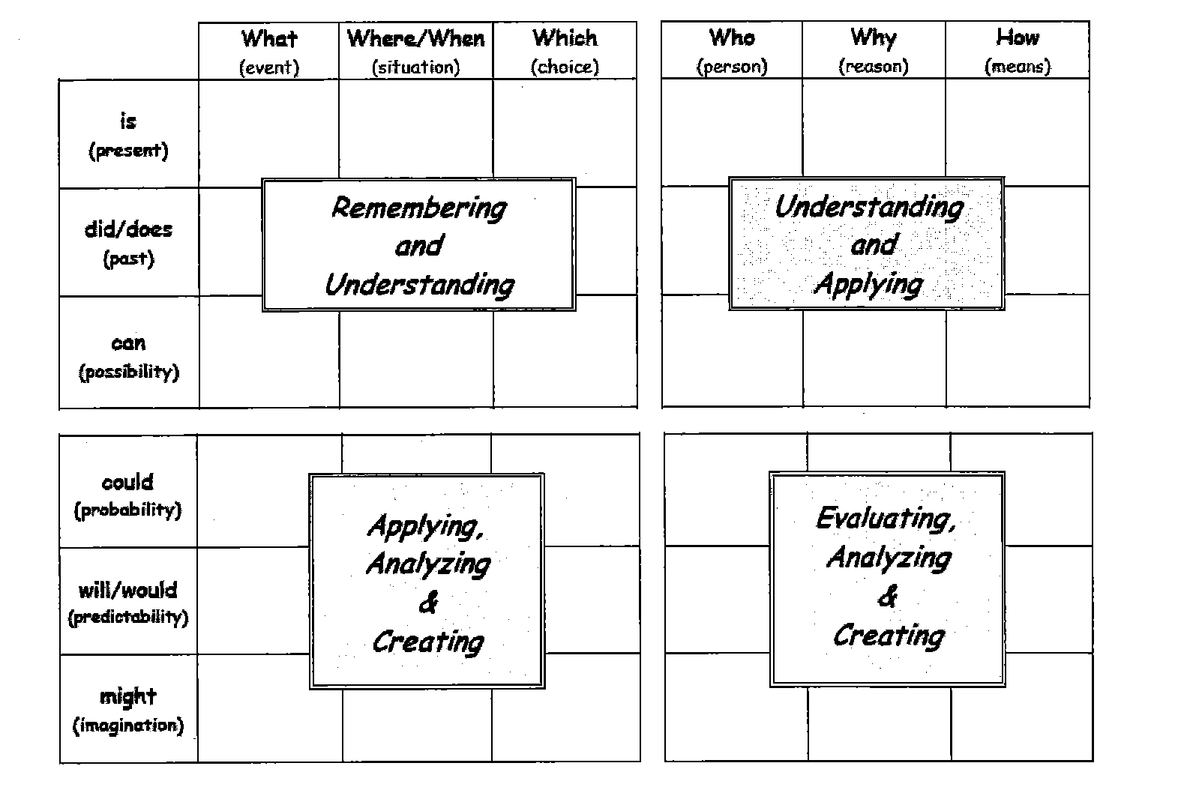
Source: https://www.pinterest.com/edmund0128/science-inquiry-skills/

Slide 90
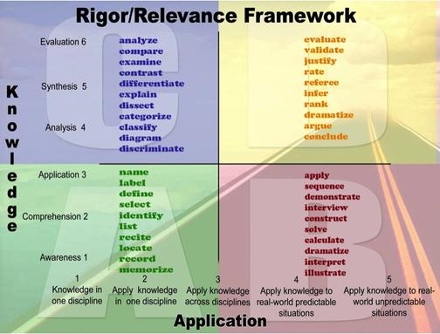
Resource: Rigor/Relevance Chart
Source: https://ccpscaoblog.files.wordpress.com/2013/08/rigor-and-relevance-verb-list.jpg

Slide 91
Looking at Grade Specific Lesson
6th Grade:
Adding and Subtracting Directed Numbers
7th Grade:
Using Positive and Negative Numbers in Context
8th Grade:
Building and Solving Linear Equations
Algebra I:
Solving Linear Equations in Two Variables
Geometry:
Sorting Equations of Circles 2
Algebra II:
Representing Polynomials Graphically

Slide 92
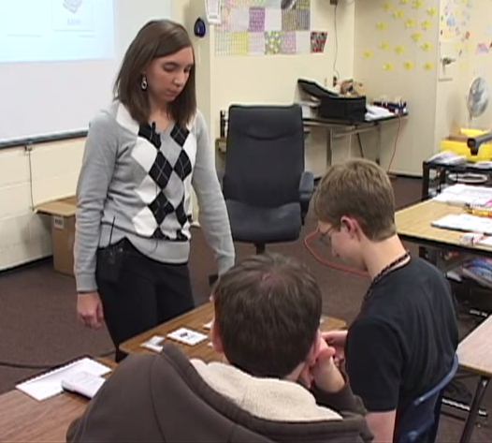
More on otes…
Example of MDC lesson
Notes:
8:15-8:45
Let’s look at the OTES Rubric (MDC Video: GATES Math Collaborative Classroom Video. Potentially have another non-MDC video) (Focus on Assessment of Student Learning standard)
Connect to MDC Classroom Challenge
Lead: Verdie

Slide 93
MDC Training
Day 1
Review of Formative Assessment
What is MDC?
Complete Concept Development as a large group
Go through MDC Resources for lesson
Complete Concept Development in Grade Level Groups. Thinking like a student.
Day 2
Review Formative Assessment
Review Format of Concept Development Lesson
Complete Problem Solving Lesson
Identifying student misconceptions and identify feedback that moves learning forward
Identify and plan a lesson to implement before
Resource: MDC Training Day 1
Resource: MDC Training Day 2

Slide 94
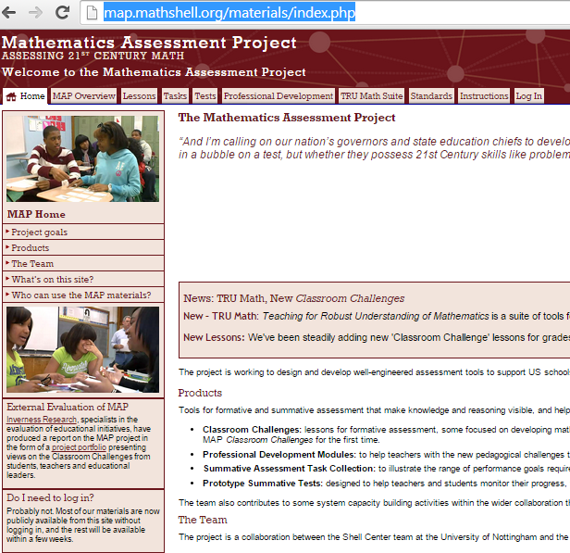
Mathematics Assessment Project
Notes:
12:00-12:15
MAP Website
Lead: Verdie

Slide 95
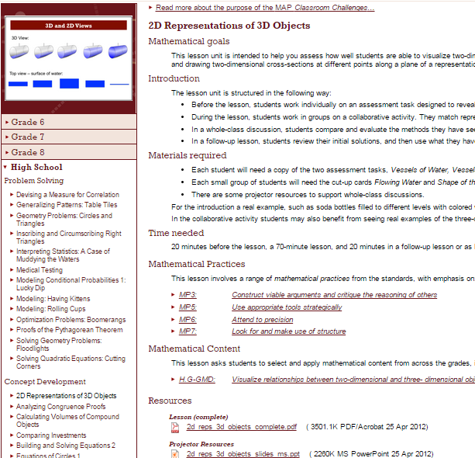
Choose your MDC Classroom Challenge
Notes:
12:15 – 1:30
Choose a lesson (worksheet for selecting a lesson) – connection between content and lessons They will have in their binders the alignment document that Scott prepared.
Lead: Scott
Planning for your lesson
All

Slide 96
Familiarize Yourself with the Lesson
Do the pre-assessment.
Identify the Obstacles, Misconceptions and Gaps (OMG’s) of the pre-assessment.
Read the lesson plan through carefully, working the tasks and visualizing the sequence of activities for your students. Again, anticipate the different approaches students may take and the difficulties they will encounter. Also Identify the OMG’s of the lesson.
Resource: Lesson Worksheet

Slide 97
After Familiarizing Yourself with Lesson
3) What are the big mathematical ideas of the lesson?
4) What might be conceptually difficult? What ideas will need emphasis through questioning?
5) What type of questions can I ask my students to help them with the OMG’s of the pre-assessment and the lesson? You can look at the suggested questions in the lesson plan.
What questions might students ask? How will I respond and/or deal with these?
Resource: Lesson Worksheet

Slide 98
After Familiarizing Yourself with Lesson
7) What are the different strategies students may use?
8) What kinds of question might I ask students that are stuck, or are using an incorrect strategy etc.?
9) How can student-to-student discussion of the mathematics be encouraged?
Resource: Lesson Worksheet

Slide 99
How can I help teachers after we train them in MDC?
Help teachers get resources ready for there first implementation
Try to meet with the teachers after they have students complete pre-assessment to work on grouping/misconceptions/feedback questions
Try to be present with teachers the day they implement first MDC lesson
Offer time to debrief with teachers after they implement first lessons

