Slide 1

Introduction to the
Math Design Collaborative
Sponsored by the
Cuyahoga Valley Career Center
and the
Ohio High Schools That Work, NE region
September 7 - 8, 2016
Presenters:
Kate Golden, CVCC, kgolden@cvccworks.edu
Angela Nonno, CVCC, anonno@cvccworks.edu
Chris Jones, Firelands High School, cjones@firelandsschools.org
Jack Tomasko, HSTW Coach, educoachj@aol.com
Website: http://thegoldenclassroom.weebly.com/hstw--mdc.html
Credits also given to former presenter: Scott Graham, Bay Village HS

Slide 2
WHY MDC?
differentiated instruction in classrooms
formative assessment teaching practices
student improvement data
increased rigor (PARCC math assessment)
real world applications
CCSSM hardwired!

Slide 3
Hmm. Perhaps some differentiation might be appropriate here.

Slide 4
THE MDC LESSON
Intro/
Hook
Traditional Content Delivery
MDC
FAL
Fine
Tune
Assessment
2/3 to 3/4

Slide 5
Continuing Discussions. . .
Increased Importance of Classroom Instructor
Hetero- v Homogenous Pairing
Concept Development v. Problem Solving Lessons

Slide 6
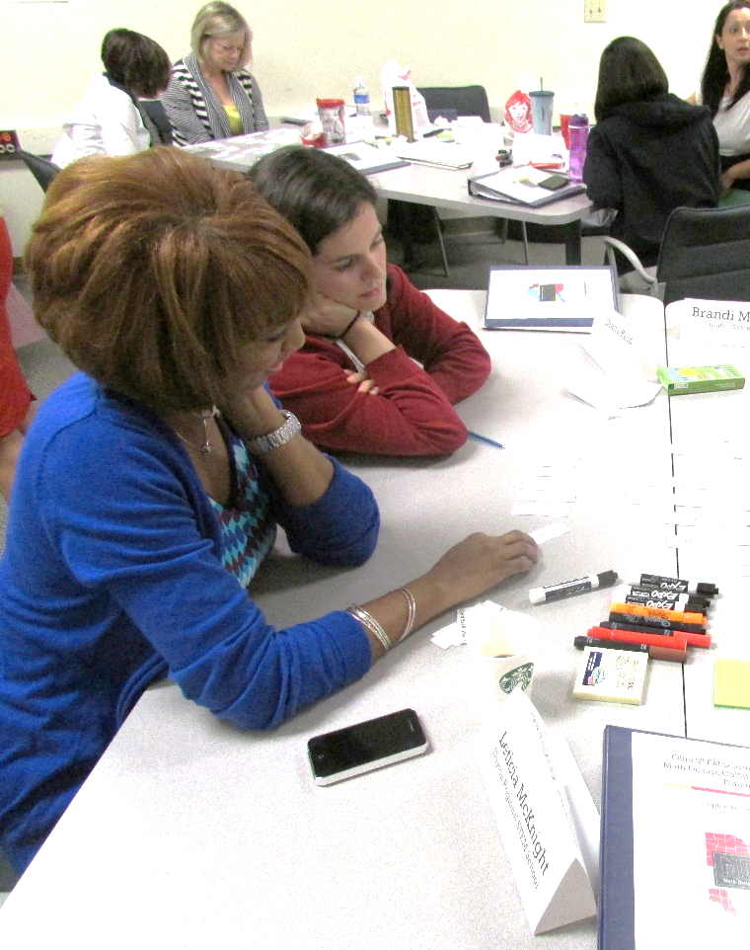
Our Agenda
Understand the big picture of formative assessment
Connect to OTES
Review structure of a Concept Development lesson
Learn key components of a Problem Solving lesson
Identifying student misconceptions and identify feedback that moves learning forward
Select and plan a lesson to implement
Notes:
Day 2 starts at 8:00 a.m.
Lead: Sandra

Slide 7
MDC Training
Day 1
Review of Formative Assessment
What is MDC?
Complete Concept Development as a large group
Go through MDC Resources for lesson
Complete Concept Development in Grade Level Groups. Thinking like a student.
Day 2
Review Formative Assessment
Review Format of Concept Development Lesson
Complete Problem Solving Lesson
Identifying student misconceptions and identify feedback that moves learning forward
Identify and plan a lesson to implement before
Resource: MDC Training Day 1
Resource: MDC Training Day 2

Slide 8
The Big Idea of
Formative Assessment
Why is this the big idea of formative assessment?
Who: Students and teachers
What: Using evidence of learning to adapt teaching and learning
Why: To meet immediate learning needs
When: Minute-to-minute and day-by-day
Marnie Thompson and Dylan Wiliam (2008)
Ann Shannon and Associates (2013)
Notes:
10:00-10:30
The Big Idea of Formative Assessment and the 5 Strategies
“Carousel” embedded in a coach-led discussion
Scott Graham

Slide 9
Where are you doing well, where could you improve?
5 Key Strategies for
Formative Assessment
Clarifying and sharing learning intentions and criteria for success;
Engineering effective classroom discussions, questions, and learning tasks;
Providing feedback that moves learners forward;
Activating students as instructional resources for one another; and
Activating students as owners of their own learning.
(Thompson and Wiliam, 2008)
Notes:
10:00-10:30
The Big Idea of Formative Assessment and the 5 Strategies
“Carousel” embedded in a coach-led discussion
Lead: Scott

Slide 10
MDC Training
Day 1
Review of Formative Assessment
What is MDC?
Complete Concept Development as a large group
Go through MDC Resources for lesson
Complete Concept Development in grade level groups, thinking as a student.
Day 2
Review Formative Assessment
Review Format of Concept Development Lesson
Complete Problem Solving Lesson
Identifying student misconceptions and identify feedback that moves learning forward
Identify and plan a lesson to implement before
Resource: MDC Training Day 1
Resource: MDC Training Day 2

Slide 11

OTES
And how it connects to MDC classroom challenges.
Notes:
9:30-10:00
OTES activity
Relevance/and purpose to the training: “Four Corners” activity
Lead: Verdie

Slide 12
OTES/Teacher Evaluation
Materials Needed:
Chart Paper
Markers
Strategies to look at:
Lesson Delivery
Differentiation
Assessment of Learning
Assessment Data
Activity:
Split into four groups
Look at Teacher Evaluation Rubric and identify how and give evidence on how a MDC lesson can help you get Proficient/Accomplished
Present findings to all the teachers
Resource: OTES Rubric

Slide 13
Structure of a
Concept Development FAL
Concept Development
Framing the lesson
Pre-lesson assessment
Introduction
Collaborative Activity
Whole-class Discussion
Feedback Questions
Post-lesson assessment

Slide 14
Enacting a Problem Solving Lesson
Purpose:
To familiarize you with the structure of a Problem Solving Lesson.
To address the differences in the two types of formative assessment lessons.
Notes:
9:10 – 9:30
Intro to Problem Solving Lesson
Pre-assessment for problem-solving
(break is embedded)
Lead: Sandra

Slide 16
Lesson Format
Improve Individual Solution (10 Min)
Collaborative Small Group Work (15 Min)
Collaborative analysis of Sample Responses (15 Min)
Whole Class Discussion (20 Min)
Follow-Up Lesson: Individual Reflection (10 Min)

Slide 17
Questions for Table Tiles
If you were to buy ¼ pieces, ½ pieces and whole piece how many would you need to buy for the 40cm by 40cm table?
Read the rubric. Where does Maria use quarter tiles? Half Tiles?
What do you notice about the difference between the numbers of whole tiles in one table top to the next?
4) What is the width and length of the table you just created in your diagram?
5) Figure out the number of ¼ pieces, ½ pieces and whole pieces of a 30x30 tabletop by drawing it. After figuring that, look at the 20x20 and 40x40 tile numbers. Without drawing make a hypothesis on the number of tiles (1/4 pieces, ½ pieces and whole pieces) needed for a 50x50 table. After making your hypothesis check to see if you were right.
6) How can you write your answer using mathematical language?
7) How could you explain how you reached your conclusions so that another class understands?

Slide 18
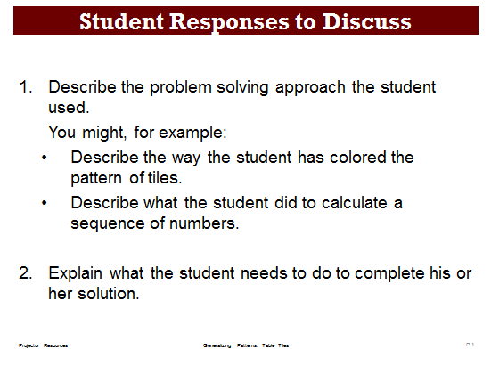
Notes:
9:55 – 10:10
Collaborative analysis of Sample Responses to Discuss (15 minutes)
Lead: Verdie

Slide 19
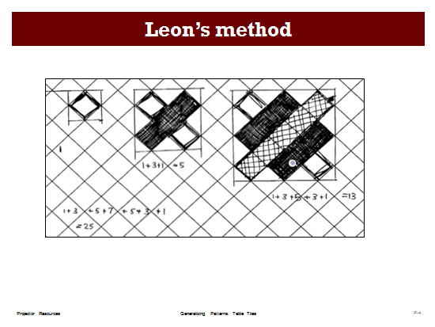
Notes:
10:10- 10:30
Whole-class discussion comparing different approaches (20 minutes)
Lead: Verdie

Slide 20
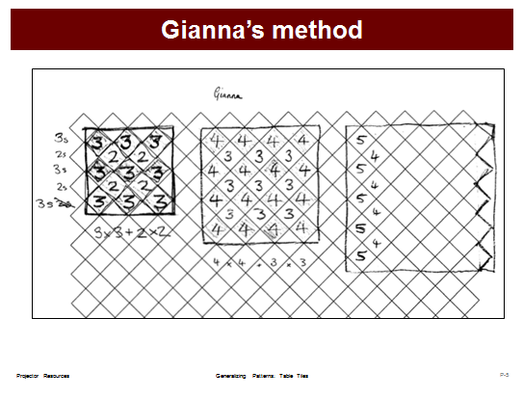
Notes:
10:10- 10:30
Whole-class discussion comparing different approaches (20 minutes)
Lead: Verdie

Slide 21
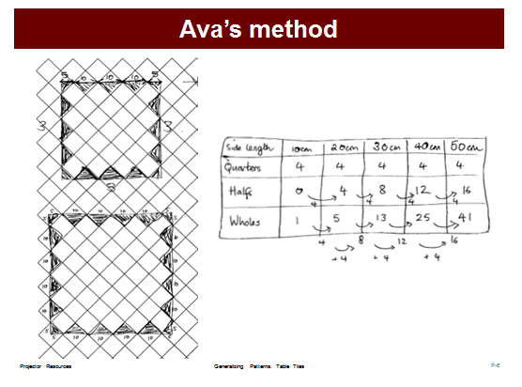
Notes:
10:10- 10:30
Whole-class discussion comparing different approaches (20 minutes)
Lead: Verdie

Slide 22
Make sure students have their original individual work on the Table Tiles task. Give them a fresh, blank copy of the Table Tiles task sheet and also the Grid Paper.
Read through your original responses and think about what you have learned this lesson.
Using what you have learned, try to improve your work.
If a student is satisfied with his or her solution, ask the student to try a different approach to the problem and to compare the approach already used.
Notes:
10:30-11:00
Review individual solutions to the assessment task
This should be a very brief overview of what the students would be doing at this point. At this point, we should just transition into teachers looking over student responses.
Lead: Scott

Slide 23
T-1

Slide 25
T-2

Slide 27
T-3

Slide 28
T-5

Slide 29
T-6

Slide 30
T-8

Slide 31
Structure of a
Formative Assessment Lesson
Concept Development
Framing the lesson
Pre-lesson assessment
Introduction
Collaborative Activity
Whole-class Discussion
Feedback Questions
Post-lesson assessment
Problem Solving
Framing the lesson
Pre-lesson assessment
Feedback Questions
Introduction
Collaborative Activity
Examining Student Work
Whole-class Discussion
How Did You Work
Problem Solving
Framing the lesson
Pre-lesson assessment
Feedback Questions
Introduction
Collaborative Activity
Examining Student Work
Whole-class Discussion
Problem Solving
Framing the lesson
Pre-lesson assessment
Feedback Questions
Introduction
Collaborative Activity
Examining Student Work
Problem Solving
Framing the lesson
Pre-lesson assessment
Feedback Questions
Introduction
Collaborative Activity
Problem Solving
Framing the lesson
Pre-lesson assessment
Feedback Questions
Introduction
Problem Solving
Framing the lesson
Pre-lesson assessment
Feedback Questions
Problem Solving
Framing the lesson
Pre-lesson assessment
Problem Solving
Framing the lesson
Problem Solving
VS.
Notes:
11:00-11:30
Differences in CD and PS Classroom Challenges
Comment on:
1. How are groups chosen within problem solving lessons?
2. Where are problem solving lessons placed within a unit?
Lead: Scott

Slide 32
Videos of People Enacting Lesson
Collaborative Activity
http://vimeo.com/73705804
Classroom Discussion
http://vimeo.com/73706010

Slide 33
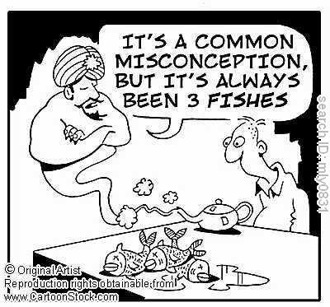
Standard Form: | Factored Form: 2 is greater than 4 | Completed Square Form:
y = x² – 10x + 24 | y = (x – 4)(x – 6) | y = (x – 5)² – 1
Notes:
1:20-1:45
(Video: 2 is greater than 4)
Analyzing student responses (give teachers sample student responses)
Misconceptions (have them go and identify some misconceptions)
Feedback questions (think about feedback questions) Discuss how they should be.
Lead: Sandra

Slide 34
Identifying Misconceptions/
Measuring Student Growth
Identify student misconceptions on pre-assessment
Enter misconceptions on spreadsheet to measure growth
Will post it on my website
Click on MDC Data Sheet
Example Data Chart

Slide 35

Effective Feedback
Goal referenced
  Does the feedback cause students to think more deeply about the key math?
  Does the feedback solve an issue that arises out of the student work?
Actionable
  Can the student answer the feedback question with more than a Yes or No?
User friendly
  Does the feedback evidence a genuine interest in understanding more fully the student work?
Grant Wiggens (2012)
Ann Shannon and Associates (2013)
Notes:
1:20-1:45
This is adapted from both Ann Shannon and Associates “Criteria for Feedback” and Grant Wiggins “7 keys to effective feedback” (http://www.ascd.org/publications/educational-leadership/sept12/vol70/num01/Seven-Keys-to-Effective-Feedback.aspx).
Lead: Sandra

Slide 36
Criteria for Feedback
• The feedback is designed to solve an issue that arises out of the student work
• The feedback is designed to cause students to think more deeply about the mathematics
• The feedback question can be answered in writing by an adult
• The feedback question does not require a Yes or No answer
• The feedback evidences a genuine interest in understanding more fully the student work

Slide 37
Thinking about why we ask questions
What different types of questions are there?
What different functions do your questions serve?
What types of questions do you use most frequently?
What common mistakes do you make when asking questions?
What are the unintended effects of each of these mistakes?

Slide 38
What types of questions develop thinking and reasoning?
What types of questions promote thinking and reasoning?
Give some examples that you have recently used.
Reflect on the implications of these ideas for your own practice.

Slide 39
Effective Questioning
The teacher plans questions that encourage thinking and reasoning
Everyone is included
Students are given time to think
The teacher avoids judging students’ response.
Students’ responses are followed up in ways that encourage deeper thinking.

Slide 40
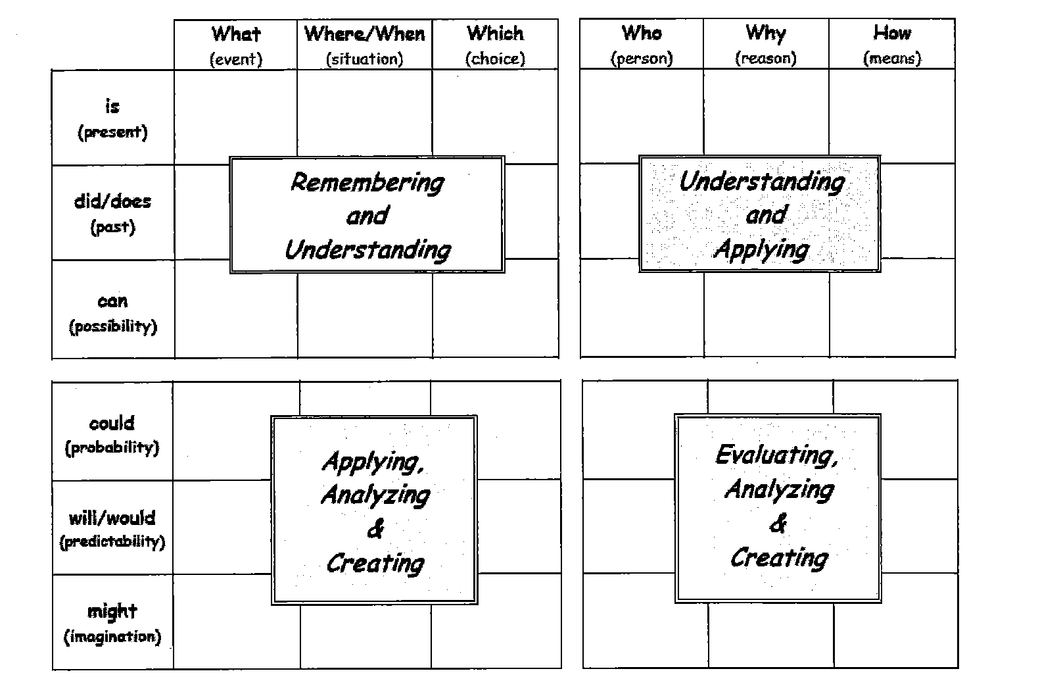
Source: https://www.pinterest.com/edmund0128/science-inquiry-skills/

Slide 41
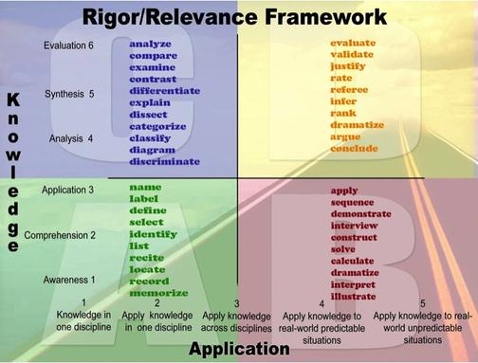
Resource: Rigor/Relevance Chart
Source: https://ccpscaoblog.files.wordpress.com/2013/08/rigor-and-relevance-verb-list.jpg

Slide 42
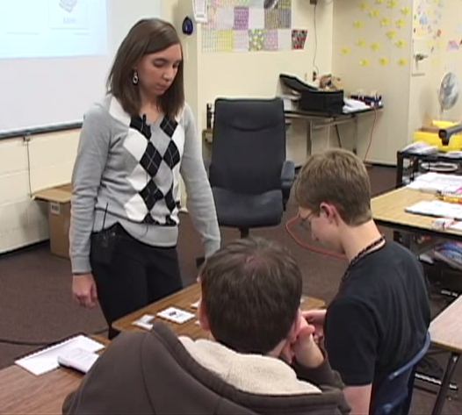
More on otes…
Example of MDC lesson
Notes:
8:15-8:45
Let’s look at the OTES Rubric (MDC Video: GATES Math Collaborative Classroom Video. Potentially have another non-MDC video) (Focus on Assessment of Student Learning standard)
Connect to MDC Classroom Challenge
Lead: Verdie

Slide 43
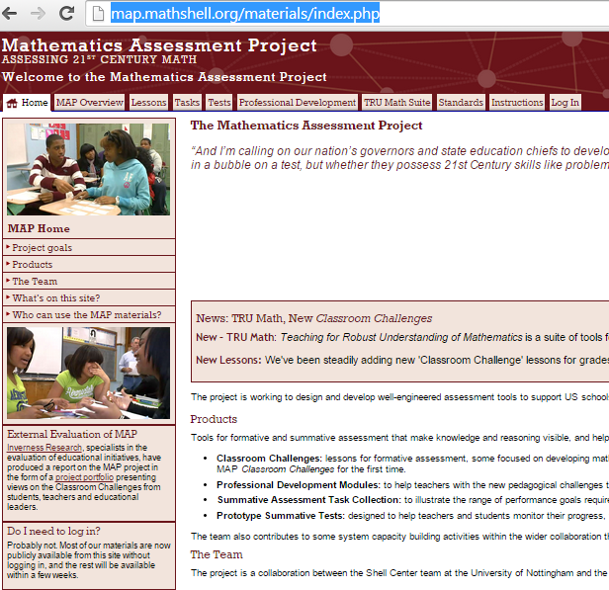
Mathematics Assessment Project
Notes:
12:00-12:15
MAP Website
Lead: Verdie

Slide 44
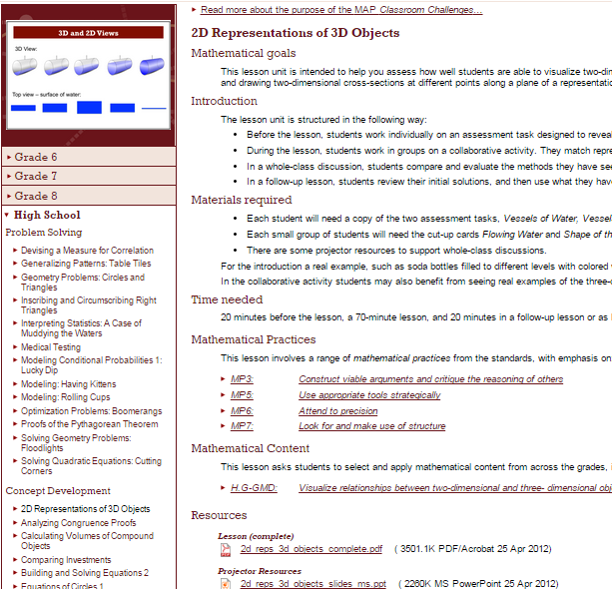
Choose your MDC Classroom Challenge
Notes:
12:15 – 1:30
Choose a lesson (worksheet for selecting a lesson) – connection between content and lessons They will have in their binders the alignment document that Scott prepared.
Lead: Scott
Planning for your lesson
All

Slide 45
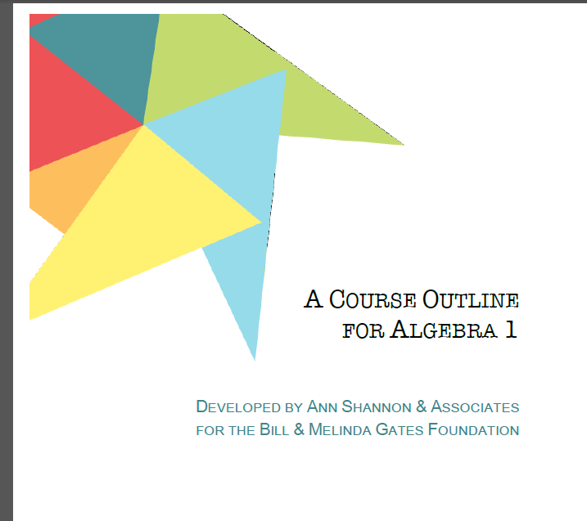
Planning MDC

Slide 46
Tasks? What are these?

Slide 47
Pythagorean Triples Task

Slide 48
Web Addresses
Classroom Challenges at http://www.map.mathshell.org
Changing Educational Paradigms at
https://www.youtube.com/watch?v=zDZFcDGpL4U&list=RDPtZ1pmY0VzI&index=4
Traffic Lights at
https://www.youtube.com/watch?v=J25d9aC1GZA&list=RDPtZ1pmY0VzI&index=3
Lollipop Sticks at
https://www.youtube.com/watch?v=PtZ1pmY0VzI
Making Math Matter at
http://collegeready.gatesfoundation.org/Learning/MathDesignCollaborative
Teaching MDC video’s at
http://asamaths.com

