Slide 1

Introduction to the
Math Design Collaborative
Sponsored by the
Cuyahoga Valley Career Center
and the
Ohio High Schools That Work, NE region
September 7 - 8, 2016
Presenters:
Kate Golden, CVCC, kgolden@cvccworks.edu
Angela Nonno, CVCC, anonno@cvccworks.edu
Chris Jones, Firelands High School, cjones@firelandsschools.org
Jack Tomasko, HSTW Coach, educoachj@aol.com
Website: http://thegoldenclassroom.weebly.com/hstw--mdc.html
Credits also given to former presenter: Scott Graham, Bay Village HS

Slide 2
“The road to prosperity goes straight through our school houses.”
“Teachers all tell us that their top two job frustrations are
(1) being disconnected from their professional community, and
(2) having no time for anything.”
--Melinda Gates, HSTW Staff Dev Conf, 7/14/14

Slide 3
Please record on the index card:
Name
Site/building name
Primary course to be taught in ‘15-16

Slide 4
WHY MDC?
differentiated instruction in classrooms
formative assessment teaching practices
student improvement data
increased rigor (OH math assessment)
real world applications
CCSSM hardwired!

Slide 5
THE TRADITIONAL LESSON
Intro/
Hook
Traditional
Content Delivery
Reteach?
Assessment
Typical Unit of Mathematics Instruction

Slide 6
THE MDC LESSON
Intro/
Hook
Traditional Content Delivery
MDC
FAL
Fine
Tune
Assessment
2/3 to 3/4

Slide 7

Early Indications. . .
Kentucky
State Dept of Education

Slide 8
Early Indications. . .
“ . . . the studies found statistically significant learning effects for both tools, the approximate equivalent of 2.2 months of schooling for LDC and 4.6 months for MDC. Given their contexts of early implementation and limited dosage, these small effects are noteworthy.”
--Implementation & Effect of LDC and MDC in Kentucky Districts

Slide 9
MDC Training
Day 1
Review of Formative Assessment
What is MDC?
Complete a Concept Development lesson as a large group
Review MDC lesson resources
Complete a Concept Development lesson in grade level groups, thinking as a student
Day 2
Review Formative Assessment
Review format of a Concept Development lesson
Complete a Problem Solving lesson
Identifying student misconceptions and identify feedback that moves learning forward
Identify and plan a lesson to implement

Slide 10
Learning Targets
Learn what is the Math Design Collaborative (MDC)
Learn how MDC aligns with the Formative Assessment process
Learn about the critical elements of an MDC lesson.

Slide 11
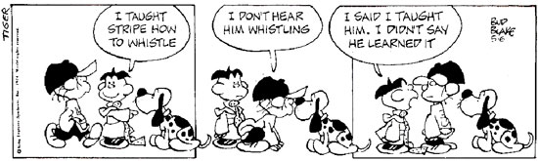

Slide 12
What are the biggest struggles we face as teachers in regards to student’s understanding of mathematics?

Slide 13
Paradigm Shift in Education

Slide 14
MDC Training
Day 1
Review of Formative Assessment
What is MDC?
Complete a Concept Development lesson as a large group
Review MDC lesson resources
Complete a Concept Development lesson in grade level groups, thinking as a student.

Slide 15
ONE BIG IDEA OF
FORMATIVE ASSESSMENT
Students and teachers continuously using evidence of learning to adapt what happens in the classroom

Slide 16
Strategy #1
Clarifying, sharing, and understanding learning targets & success criteria

Slide 17
Strategy #2
Engineering effective classroom discussions, questions and learning tasks that elicit evidence of learning

Slide 18
Strategy #3
Providing feedback that
moves learners forward

Slide 19
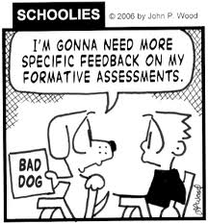
Quality Feedback?

Slide 20
Strategy #4
Activating learners as the
owners of their own learning

Slide 21
Strategy #5
Activating learners as
instructional resources for one another

Slide 22
Activity
How do you currently implement Formative Assessment in your classroom?
Notes:
How do you implement Formative Assessment in your classroom?
Split Group of teacher into five groups
Have each group look at each of the five formative assessment strategies and identify how they implement each of the strategies
Rotate ever two minutes
Have teachers at the last chart paper identify the best idea of that formative assessment strategy

Slide 23
THE FORMATIVE
ASSESSMENT PROCESS
 | Where the learner is going? | Where the learner is right now? | How does the learner get there?
Teacher | Clarifying and sharing learning intentions and criteria for success | Engineering effective classroom discussions, activities, and tasks that elicit evidence of learning | Providing feedback that moves learning forward
Peer | Understanding and sharing learning intentions and criteria for success | Activating learners as instructional resources for one another
Learner | Understanding learning intentions and criteria for success | Activating learners as the owners of their own learning

Slide 24
MDC Training
Day 1
Review of Formative Assessment
What is MDC?
Complete a Concept Development lesson as a large group
Review MDC lesson resources
Complete a Concept Development lesson in grade level groups, thinking as a student.
http://bit.ly/1eQbWQd

Slide 25
What is the Mathematics
Design Collaborative?
The Mathematics Design Collaborative (MDC) are lessons or tasks that aim to bring to life the Common Core State Standards (CCSSM) in a way that will help teachers and their students turn their aspirations for achieving them into classroom realities.

Slide 26
What are “Classroom Challenges”
MDC lessons that support teachers in formative assessment. They both reveal and develop students’ understanding of key mathematical ideas and applications. These lessons enable teachers and students to monitor in more detail their progress towards the targets of the standards.

Slide 27
“Classroom Challenges” are either
Concept Development lessons that focus on assessing and developing conceptual understanding, or
Problem Solving lessons that focus on the application of previously learned mathematics to non-routine problems
Notes:
Concept Development
Help students and teachers realize the CCSSM requirement that “Proficient students expect mathematics to make sense.” These lessons are designed to reveal and develop students’ conceptions, and misconceptions, of significant mathematical ideas and how these connect to their other knowledge.
Problem Solving
Help students and teachers also realize the CCSSM requirement that “They take an active stance in solving mathematical problems.” These lessons are designed to assess and develop students’ capacity to apply their mathematics flexibly to non-routine unstructured problems, both from the real world and within pure mathematics.

Slide 28
As you experience the lesson,
consider the components and determine what the student and teacher roles are.

Slide 29
MDC Training
Day 1
Review of Formative Assessment
What is MDC?
Complete a Concept Development lesson as a large group
Review MDC lesson resources
Complete a Concept Development lesson in grade level groups, thinking as a student.
http://bit.ly/1eQbWQd

Slide 30
Representing Quadratic
Functions Graphically

Slide 31
Goals and Standards of the Lesson

Slide 32
Lesson Procedures
Pre-Assessment (15 min)
Whole class intro: Key Features of Quadratics (10 min)
Whole class intro to Dominoes (10 min)
Collaborative activity: Matching Dominoes (20 min)
Sharing work (15 min)
Collaborative activity: Complete the Equations (15 min)
Sharing work (10 min)
Whole class discussion (15 min)
Follow-up lesson: Review the assessment task (10 min)

Slide 34
Matching Dominos
Take turns at matching pairs of dominos that you think belong together.
Each time you do this, explain your thinking clearly and carefully to your partner.
It is important that you both understand the matches. If you don't agree or understand, ask your partner to explain their reasoning. You are both responsible for each other’s learning.
On some cards an equation or part of an equation is missing. Do not worry about this, as you can carry out this task without this information.

Slide 35
Sharing Work
One student from each group is to visit another group's poster.
If you are staying at your desk, be ready to explain the reasons for your group's matches.
If you are visiting another group:
  Write your card matches on a piece of paper.
  Go to another group's desk and check to see which matches are different from your own.
  If there are differences, ask for an explanation. If you still don't agree, explain your own thinking.
  When you return to your own desk, you need to consider as a pair whether to make any changes to your own work.

Slide 36
MDC Training
Day 1
Review of Formative Assessment
What is MDC?
Complete a Concept Development lesson as a large group
Review MDC lesson resources
Complete a Concept Development lesson in grade level groups, thinking as a student.
http://bit.ly/1eQbWQd

Slide 37
Discussion
As you experience the lesson, consider the components and determine what the student and teacher roles are.

Slide 38
What Do the Lessons Include?
A successful, CCSSM-targeted plan to use in class.
All resources (handouts, answer keys) needed for you and your students to be successful.
Prescribed timing to complete each part of the lesson.
Note: these lessons have been well researched, field tested, refined and implemented throughout the US and UK for several years.

Slide 39
When Do I
Implement MDC Lessons?
At the beginning of the year as a great way to measure retention of prior learning.
At the end of the year to measure student retention of topics taught.
Always about 2/3 of the way through a content unit or lesson.

Slide 40
THE MDC LESSON
Intro/
Hook
Traditional Content Delivery
MDC
FAL
Fine
Tune
Assessment
2/3 to 3/4

Slide 41
IMPORTANT
This is a formative assessment lesson, therefore. . .
Students may struggle which is OK. You will have time to re-teach after the lesson.
This lesson is supposed to help us identify what we need to do after the lesson. Timing of the lesson is very important.
Teachers are guides during the process. It is OK, even good, for students to experience “productive struggle” as they move forward.

Slide 42
MDC Components
Each unit has all the resources you will need to make your lesson successful.
The following pages are provided:
-Teacher answer keys (T pages)
-Student handouts (S pages)
-Presentation resources (P pages) with Powerpoint
All FAL’s located at
map.mathshell.org

Slide 43
Introduction, Materials Needed Time (T1)

Slide 44
S1
S1 and S2

Slide 45
Assessing Students’ Responses
Do not score the responses on the pre-assessment. Research shows that students will focus on the score and other students scores rather than the math.
To move learning forward you will summarize their difficulties as a list of questions.

Slide 46
Assessing Students’ Responses
Write one or two questions on each student’s work, or
Give each student a pre-printed list of questions, and highlight the questions for each individual student.

Slide 47
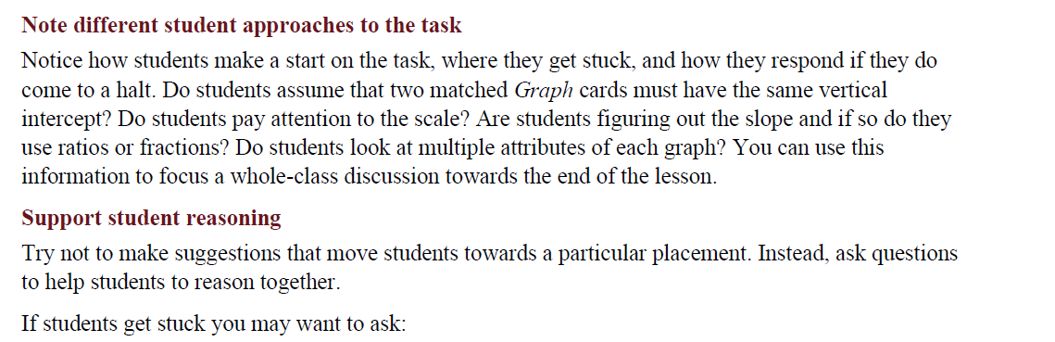

Slide 48
Assessing Students’ Responses
T-3

Slide 49
Grouping Students for Lesson
Organize class into pairs
  How?
  Identify students who have similar misconceptions on the pre-assessment and group them together.
  Why homogenous pairs?
  You are less likely to have one student control the discussion and also less likely to have a student fly under the radar.

Slide 50
Whole Class Introduction
Powerpoint slides are often provided to you as part of the lesson (at map.mathshell.org)
Representing Quadratic Functions
T4, T5

Slide 51
Whole Class Introduction to Dominoes
T5-T6

Slide 52
Collaborative Work
Matching the Dominoes
T6-T7

Slide 53
Matching Dominos
Take turns at matching pairs of dominos that you think belong together.
Each time you do this, explain your thinking clearly and carefully to your partner.
It is important that you both understand the matches. If you don't agree or understand, ask your partner to explain their reasoning. You are both responsible for each other’s learning.
On some cards an equation or part of an equation is missing. Do not worry about this, as you can complete this task without the information.

Slide 54
Collaborative Activity:
Completing The Equations
T8

Slide 55
Sharing Work
One student from each group is to visit another group's poster.
If you are staying at your desk, be ready to explain the reasons for your group's matches.
If you are visiting another group:
  Write your card matches on a piece of paper.
  Go to another group's desk to see which matches are different from your own.
  If there are differences, ask for an explanation. If you still don't agree, explain your own thinking.
  When you return to your own desk, you need to consider as a pair whether to make any changes to your own work.
T8

Slide 56
Extension Work
T8

Slide 57
Whole Class Discussion
Overcoming Misconceptions
T8

Slide 58
Follow-up Lesson
Reviewing the Assessment Task
T8

Slide 59

Parking Lot
On a post-it note record any questions that you may have regarding MDC lessons and place it on the parking lot sheet.
Lunch for 45 Minutes

Slide 60
MDC Training
Day 1
Review of Formative Assessment
What is MDC?
Complete a Concept Development lesson as a large group
Review MDC lesson resources
Complete a Concept Development lesson in grade level groups, thinking as a student.
http://bit.ly/1eQbWQd

Slide 61
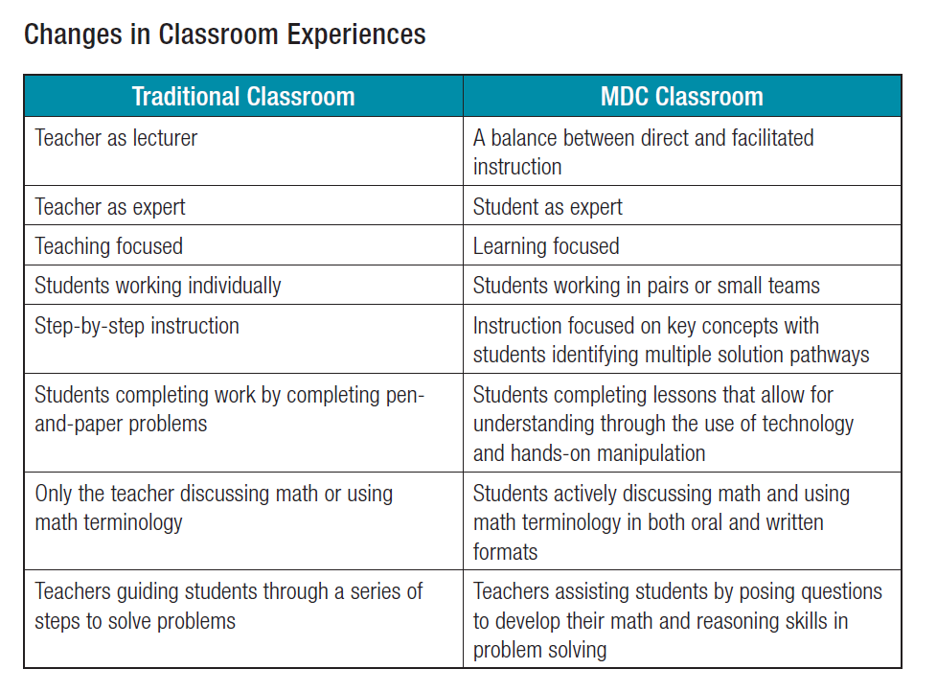

Slide 62
Math Design Collaborative Implementation

Slide 63
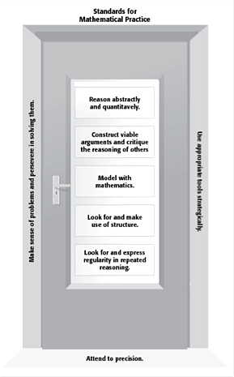

Slide 64
Looking at Grade-Specific Lessons
Middle School:
Using Positive and Negative Numbers in Context
Algebra I/Integrated I:
Building and Solving Complex Equations
Geometry/Integrated II:
Proving the Pythagorean Theorem
Algebra II/Integrated III:
Representing Polynomials Graphically

Slide 65
Familiarize Yourself with the Lesson
Complete the pre-assessment.
Identify any obstacles, misconceptions and gaps (OMG’s) of the pre-assessment.
Read the lesson plan carefully, working the tasks and visualizing the sequence of activities for your students. Again, anticipate the different approaches students may take and the difficulties they will encounter. Also, identify the OMG’s of the lesson.
Resource: Lesson Worksheet

Slide 66
After Familiarizing Yourself with the Lesson
3) What are the big mathematical ideas of the lesson?
4) What might be conceptually difficult? What ideas will need emphasis through questions?
5) What type of questions can I ask my students to help them with the OMG’s of the pre-assessment and the lesson? (You can look at the suggested questions in the lesson plan)
What questions might students ask? How will I respond and/or deal with these?
Resource: Lesson Worksheet

Slide 67
After Familiarizing Yourself with the Lesson
7) What are the different strategies students may use?
8) What kinds of question might I ask students that are stuck, or are using an incorrect strategy, etc.?
9) How can student-to-student discussion of the mathematics be encouraged?
Resource: Lesson Worksheet

Slide 68

SREB
Publication 14v10
Sept, 2014
Found at: SREB.org

Slide 69
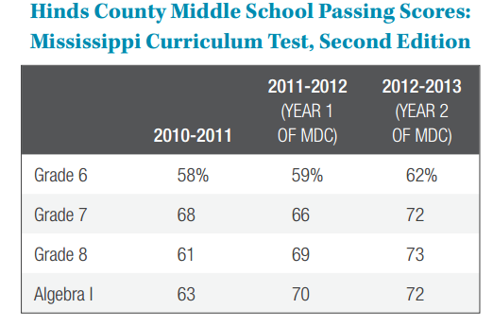

Slide 70
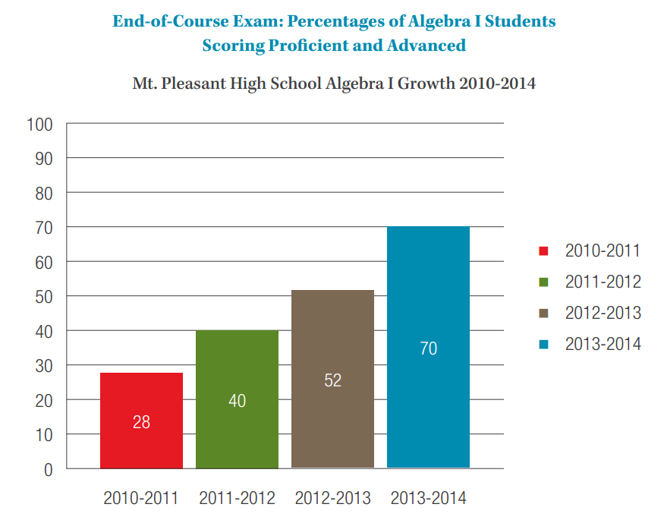
MDC Year 1 Year 2 Year 3
Mt. Pleasant, TN

Slide 71
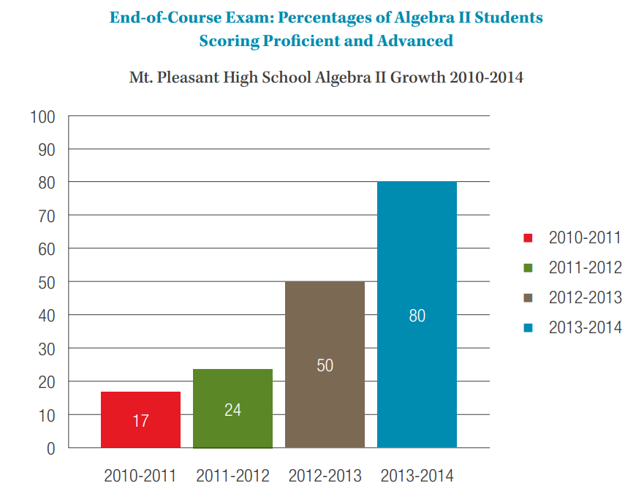
MDC Year 1 Year 2 Year 3
Mt. Pleasant, TN

Slide 72
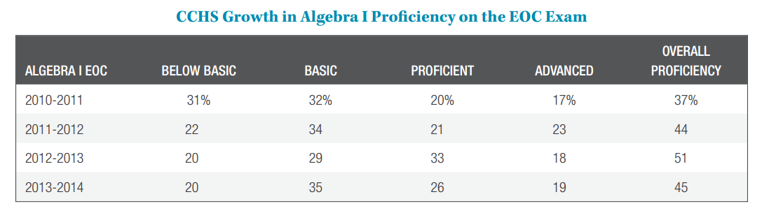
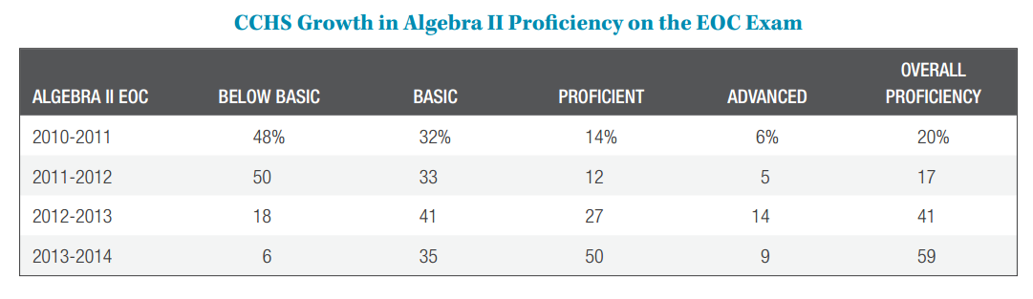
Cannon County HS, Woodbury, TN
Math Dept initiated MDC in Spring, 2012

Slide 73
Completing Pre-Assessment for a
Problem Solving Lesson
Generalizing Patterns: Table Tiles

Slide 74
Pre-lesson assessment task
Student instructions
Work on this task completely on your own (without help from me or from your fellow students).
I want to see how far you can go when presented with this problem. Expect to have to think about it. Read the task, look for a starting point, and then go back and re-read the task. Try to answer questions as carefully as you can.
This will not be graded. It is designed to show me what issues might be impeding your learning and keeping you from higher test scores.
Tomorrow we are going to do a lesson which will help you complete this task.
Time: 15 minutes
Notes:
9:10 – 9:30
Intro to Problem Solving Lesson
Pre-assessment for problem-solving
(break is embedded)
Lead: Sandra

Slide 75
Parking Lot
On a three post-it notes record answers to the following three questions:
What is the biggest thing you took away from today?
Any questions that still linger
about MDC?
How do you see yourself
implementing MDC?

Slide 76
Web Addresses
Classroom Challenges at http://www.map.mathshell.org
Changing Educational Paradigms at
https://www.youtube.com/watch?v=zDZFcDGpL4U&list=RDPtZ1pmY0VzI&index=4
Traffic Lights at
https://www.youtube.com/watch?v=J25d9aC1GZA&list=RDPtZ1pmY0VzI&index=3
Lollipop Sticks at
https://www.youtube.com/watch?v=PtZ1pmY0VzI
Making Math Matter at
http://collegeready.gatesfoundation.org/
Learning/MathDesignCollaborative

